Slide 1

By:Eng. Ahmed Mohamed Abbas
A.I.( We training )project
Object Detection

Slide 2

Project’s goal: Detect (People, bags , cars and busses) within a given set of images extracted from a video.
•Roboflow was used to assign and label the dataset.
•Used Google Colab to run the code and train the model.
•Extracted model behavior and summary from the code and Roboflow.

Slide 3

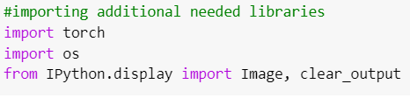


Importing the necessary libraries such as:•ultralytics
•yolov5
•roboflow
•torch
•Os
•IPython.display

Slide 4
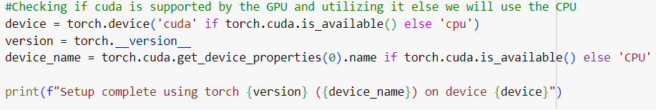
Checking if CUDA is supported by the GPU and utilizing it else we will use the CPU

Slide 5
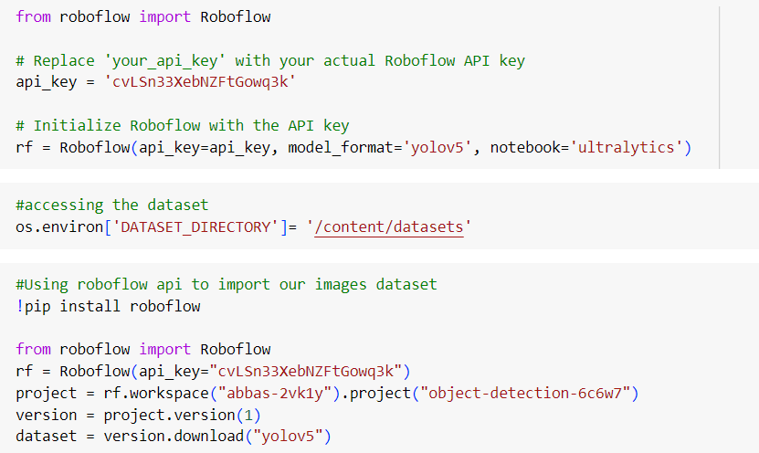
Initialize Roboflow with the API key.
•Accessing and downloading the dataset.
•And Using Roboflow api to import
our images dataset.

Slide 6
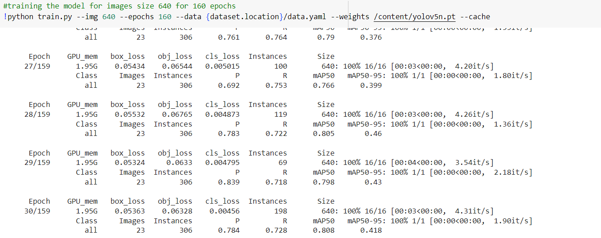
Training the model for images size 640 for 160 epochs.

Slide 7
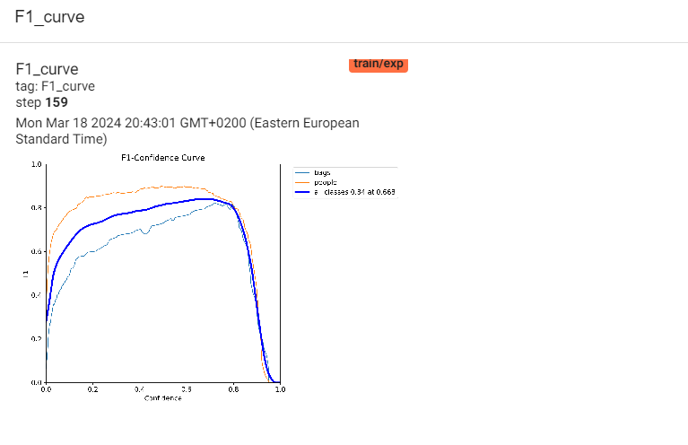
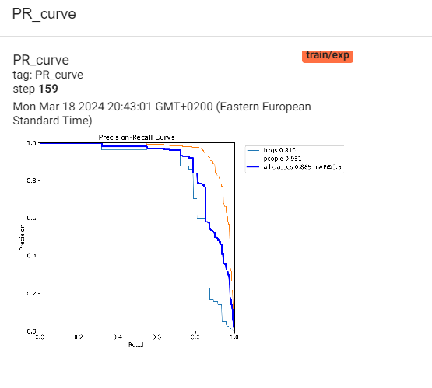
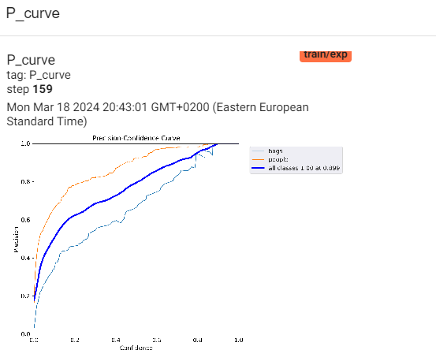

Slide 8
